Slide 1
Overfitting problem
Regularization

Slide 2
By now, you've seen a couple different learning algorithms, linear regression and logistic regression.
They work well for many problems, but when you apply them to certain machine learning applications, they
can run into a problem called overfitting that can cause them to perform very poorly.
Next:
What is overfitting problem?
Talk about a technique called regularization, that will allow us to ameliorate or to reduce this overfitting problem.

Slide 3

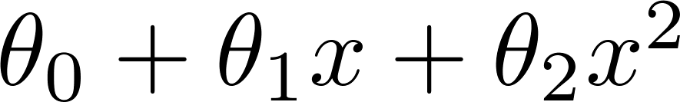
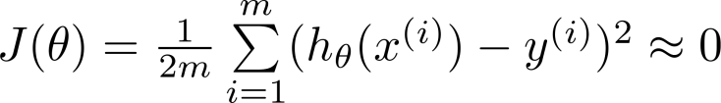
Example: Linear regression (housing prices)
Price
Price
Price
Size
Size
Size
Overfitting: If we have too many features, the learned hypothesis may fit the training set very well ( ), but fail to generalize to new examples (predict prices on new examples).

Slide 4
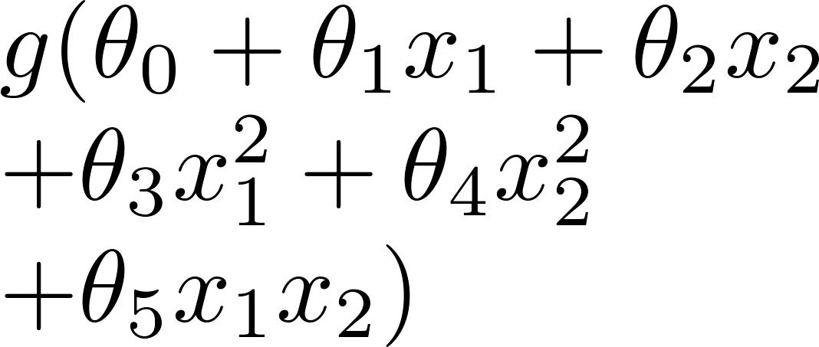
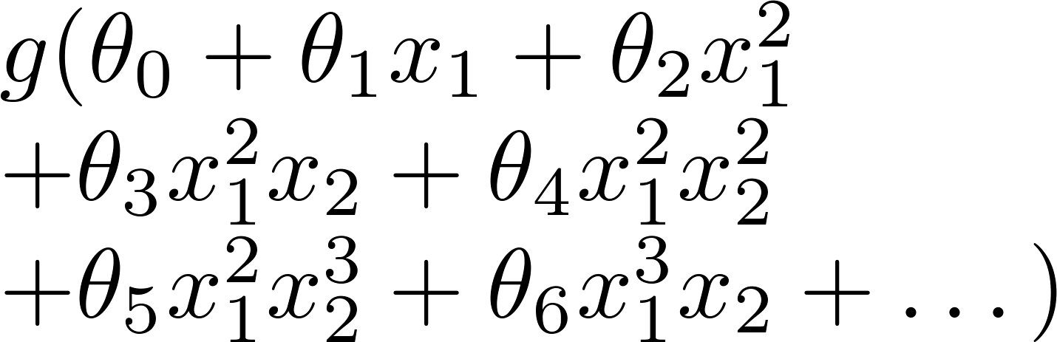
Example: Logistic regression
x₂
x₂
x₂
x₁
x₁
x₁
( = sigmoid function)

Slide 5






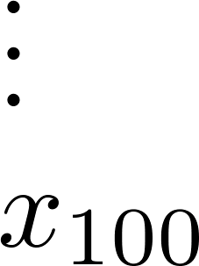
Addressing overfitting:
size of house
no. of bedrooms
Price
no. of floors
age of house
average income in neighborhood
Size
kitchen size

Slide 6


Addressing overfitting:
Options:
Reduce number of features.
Manually select which features to keep.
Model selection algorithm (later in course).
Regularization.
Keep all the features, but reduce magnitude/values of parameters .
Works well when we have a lot of features, each of which contributes a bit to predicting .

Slide 7


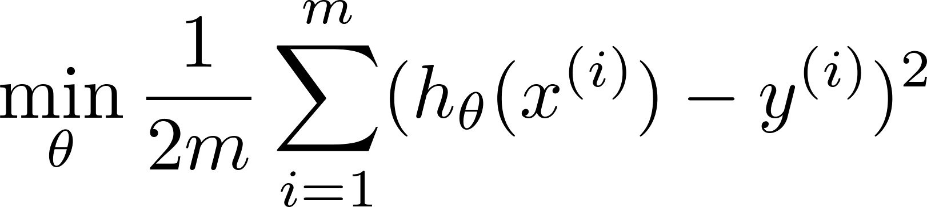
Intuition
Price
Price
Size of house
Size of house
Suppose we penalize and make , really small.

Slide 8
Cost Function (See how Regularization works and how cost function looks like?)
Regularization

Slide 9
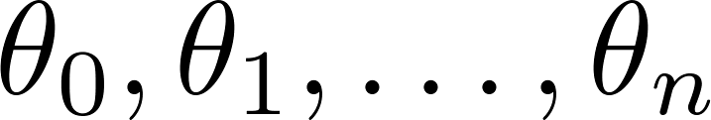
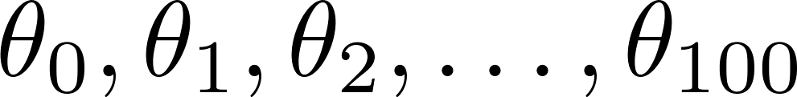
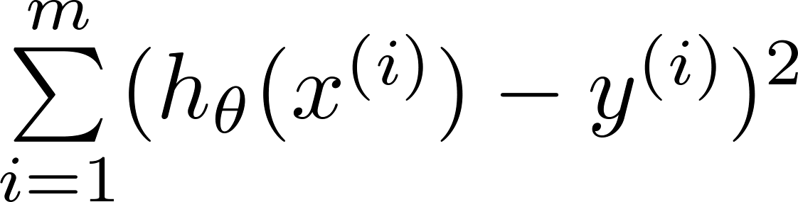
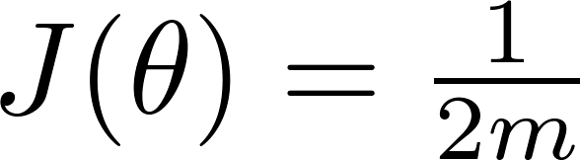
Regularization.
Small values for parameters
“Simpler” hypothesis
Less prone to overfitting
Housing:
Features:
Parameters:

Slide 10
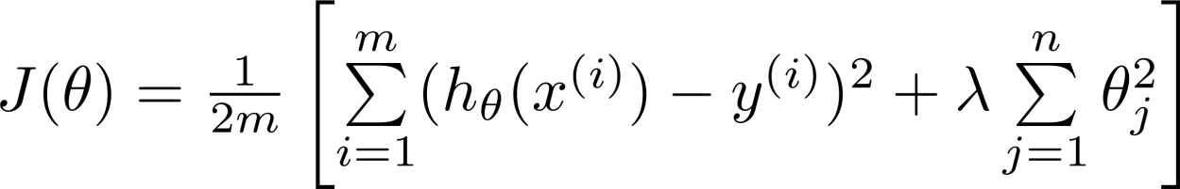
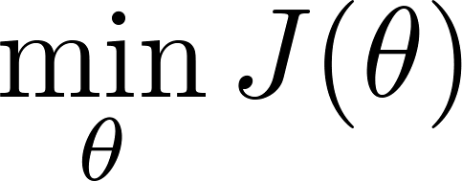
Regularization.
Price
Size of house

Slide 11

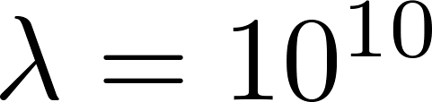
In regularized linear regression, we choose to minimize
What if is set to an extremely large value (perhaps for too large for our problem, say )?
Price
Size of house

Slide 12
Regularized Linear Regression
Regularization

Slide 13
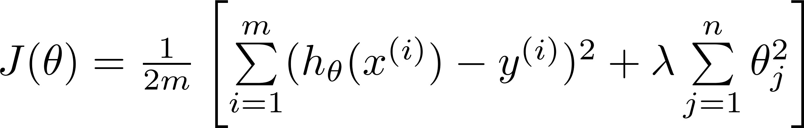
Regularized linear regression

Slide 14
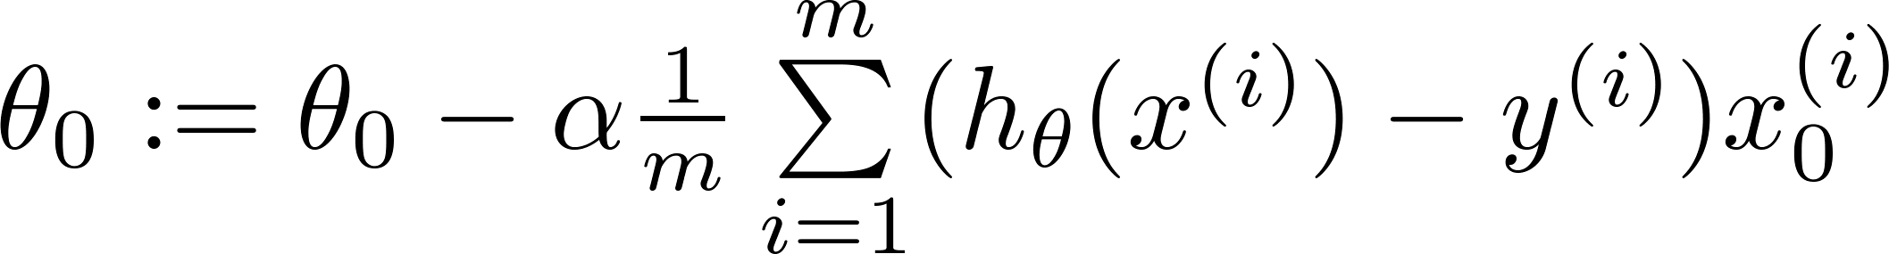
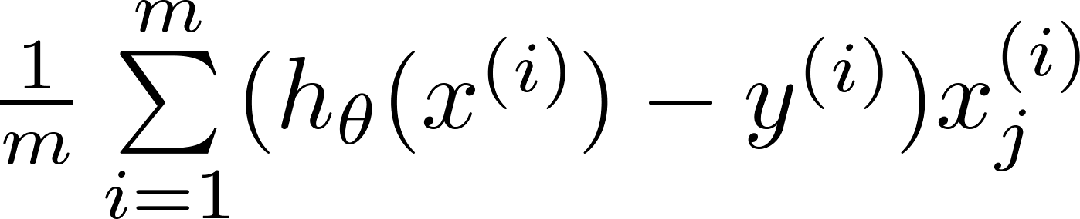
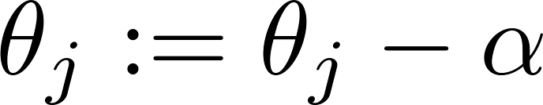

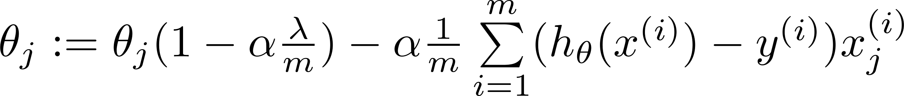
Gradient descent
Repeat

Slide 15
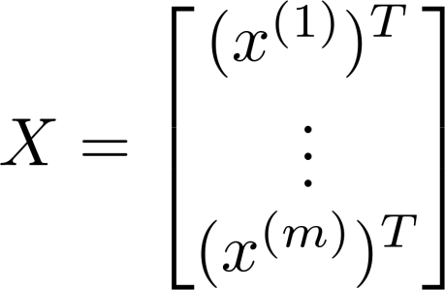
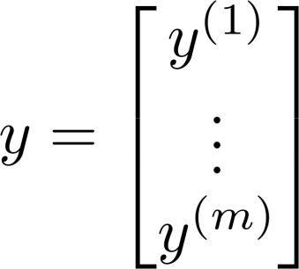
Normal equation

Slide 16
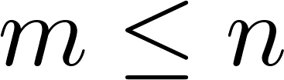
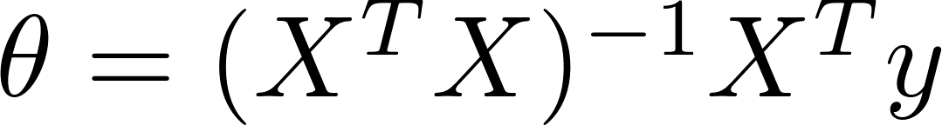

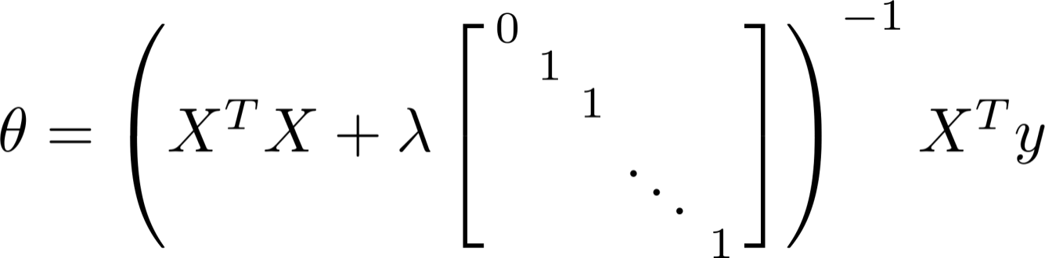
Regularized Normal Equation
Suppose ,
(#examples) (#features)
If ,

Slide 17
Regularized Logistic Regression
Regularization

Slide 18
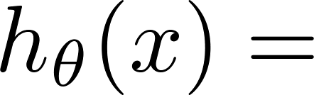
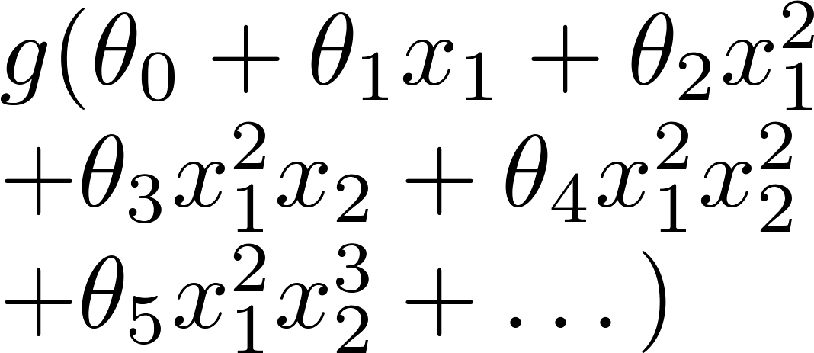
Regularized logistic regression.
x₂
x₁
Cost function:

Slide 19
Gradient descent
Repeat

Slide 20
Deciding what to try next
Advice for applying machine learning

Slide 21
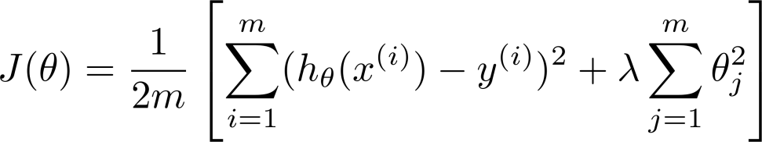
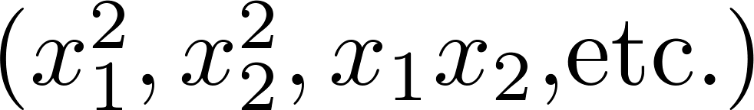
Debugging a learning algorithm:
Suppose you have implemented regularized linear regression to predict housing prices.
However, when you test your hypothesis on a new set of houses, you find that it makes unacceptably large errors in its predictions. What should you try next?
Get more training examples
Try smaller sets of features
Try getting additional features
Try adding polynomial features
Try decreasing
Try increasing

Slide 22
Machine learning diagnostic:
Diagnostic: A test that you can run to gain insight what is/isn’t working with a learning algorithm, and gain guidance as to how best to improve its performance.
Diagnostics can take time to implement, but doing so can be a very good use of your time.

Slide 23
Evaluating a Hypothesis
Advice for applying machine learning

Slide 24
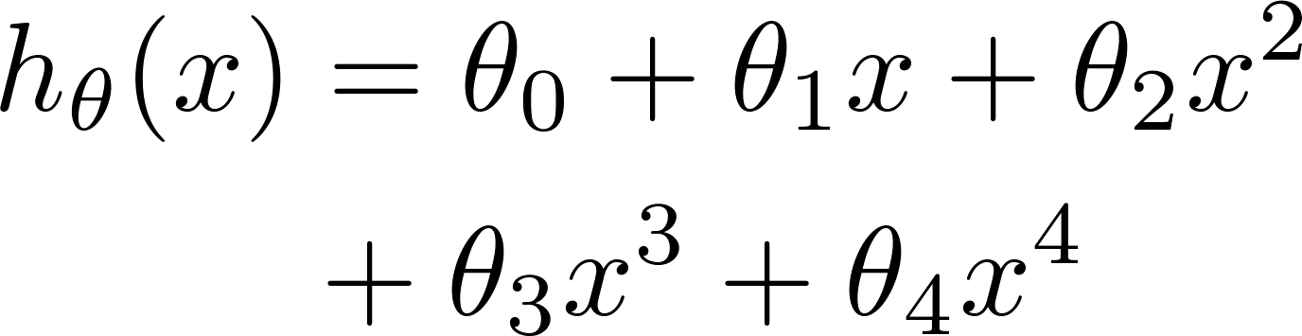
Evaluating your hypothesis
Fails to generalize to new examples not in training set.
price
size of house
no. of bedrooms
no. of floors
size
age of house
average income in neighborhood
kitchen size

Slide 25






Evaluating your hypothesis
Dataset:
Size | Price
2104 | 400
1600 | 330
2400 | 369
1416 | 232
3000 | 540
1985 | 300
1534 | 315
1427 | 199
1380 | 212
1494 | 243

Slide 26

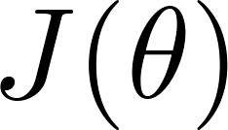
Training/testing procedure for linear regression
Learn parameter from training data (minimizing training error )
Compute test set error:

Slide 27
Training/testing procedure for logistic regression
Learn parameter from training data
Compute test set error:
Misclassification error (0/1 misclassification error):

Slide 28
Model selection and training/validation/test sets
Advice for applying machine learning

Slide 29
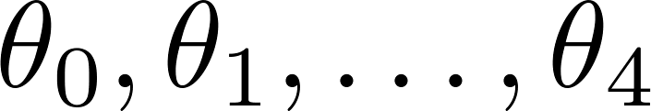
Overfitting example
Once parameters
were fit to some set of data (training set), the error of the parameters as measured on that data (the training error xxxxx) is likely to be lower than the actual generalization error.
price
size

Slide 30

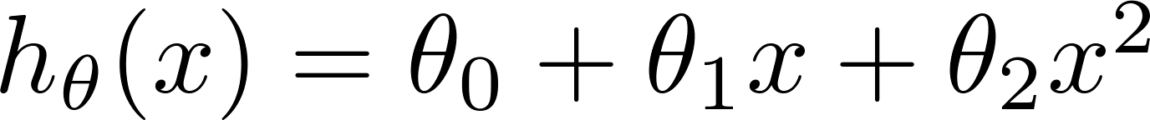
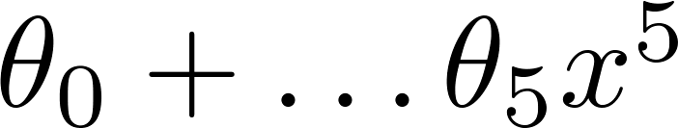
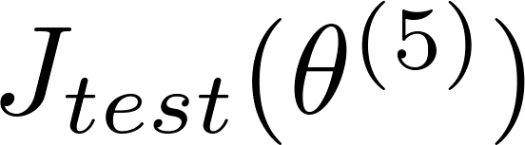

Model selection
1.
2.
3.
10.
Choose
How well does the model generalize? Report test set error .
Problem: is likely to be an optimistic estimate of generalization error. I.e. our extra parameter ( = degree of polynomial) is fit to test set.

Slide 31








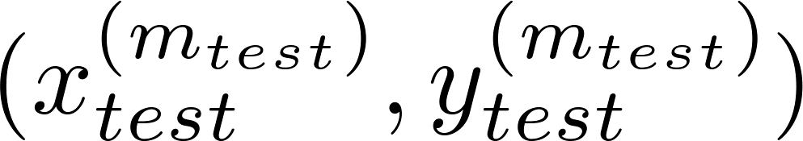
Evaluating your hypothesis
Dataset:
Size | Price
2104 | 400
1600 | 330
2400 | 369
1416 | 232
3000 | 540
1985 | 300
1534 | 315
1427 | 199
1380 | 212
1494 | 243

Slide 32
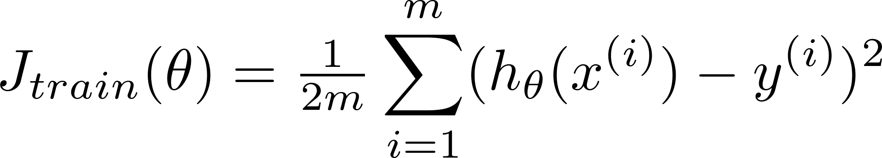
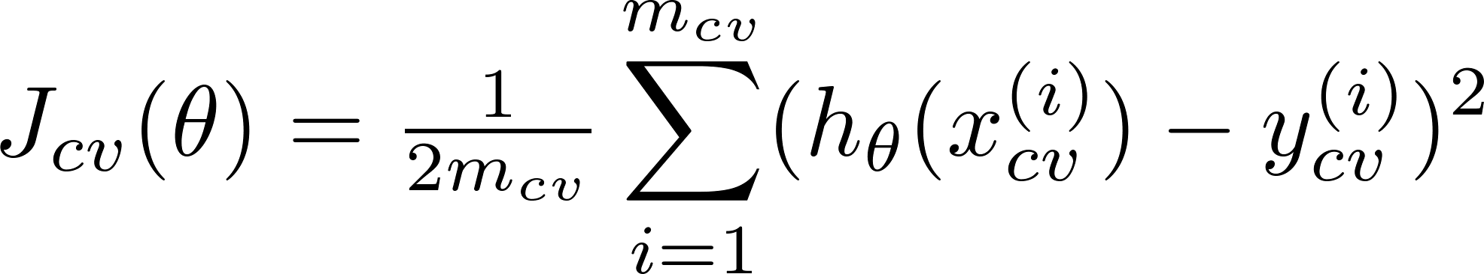
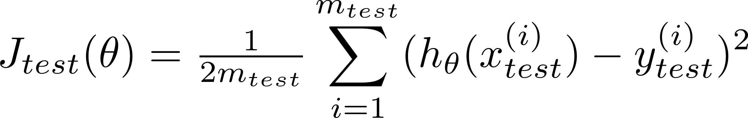
Train/validation/test error
Training error:
Cross Validation error:
Test error:

Slide 33
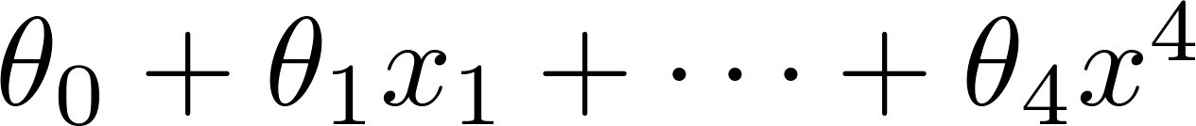
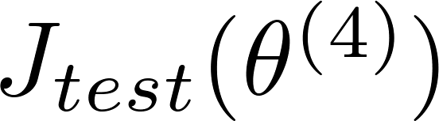
Model selection
1.
2.
3.
10.
Pick
Estimate generalization error for test set

Slide 34
Diagnosing bias vs. variance
Advice for applying machine learning

Slide 35
Bias/variance
Price
Price
Price
Size
Size
Size
High bias
(underfit)
“Just right”
High variance
(overfit)

Slide 36
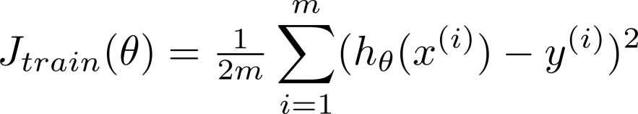
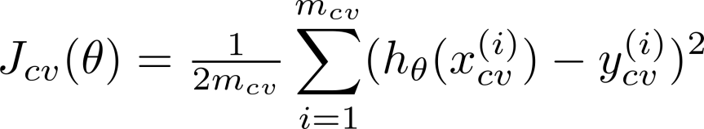
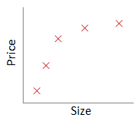
Bias/variance
Training error:
Cross validation error:
error
degree of polynomial d

Slide 37




Diagnosing bias vs. variance
Suppose your learning algorithm is performing less well than you were hoping. ( or is high.) Is it a bias problem or a variance problem?
Bias (underfit):
(cross validation
error)
error
Variance (overfit):
(training error)
degree of polynomial d

Slide 38
Regularization and bias/variance
Advice for applying machine learning

Slide 39

Linear regression with regularization
Model:
Price
Price
Price
Size
Size
Size
Large xx
High bias (underfit)
Intermediate xx
“Just right”
Small xx
High variance (overfit)

Slide 40
Choosing the regularization parameter

Slide 41
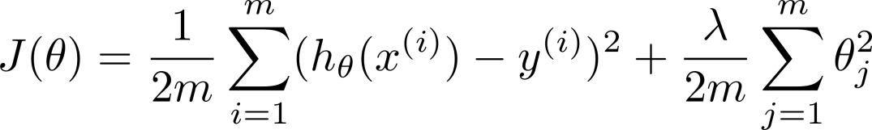







Choosing the regularization parameter
Model:
Try
Try
Try
Try
Try
Try
Pick (say) . Test error:

Slide 42
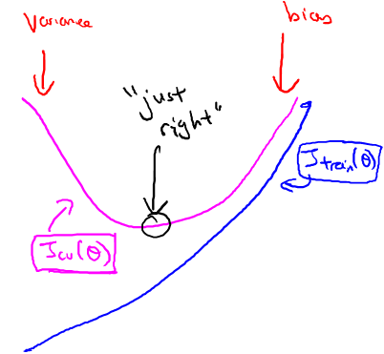
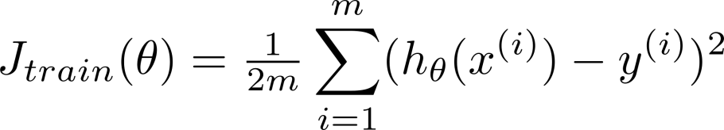
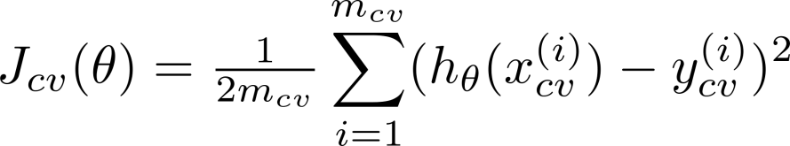
Bias/variance as a function of the regularization parameter

Slide 43
Learning Curves
Advice for applying machine learning

Slide 44

Learning curves
error
(training set size)

Slide 45

High bias
price
error
size
(training set size)
price
If a learning algorithm is suffering from high bias, getting more training data will not (by itself) help much.
size

Slide 46
High variance
(and small )
error
price
size
(training set size)
price
If a learning algorithm is suffering from high variance, getting more training data is likely to help.
size

Slide 47
Deciding what to try next (revisited)
Advice for applying machine learning

Slide 48
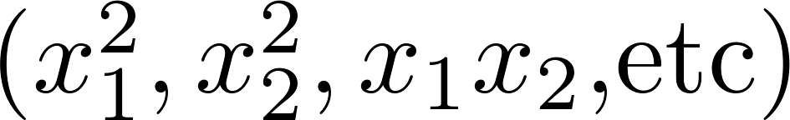
Debugging a learning algorithm:
Suppose you have implemented regularized linear regression to predict housing prices. However, when you test your hypothesis in a new set of houses, you find that it makes unacceptably large errors in its prediction. What should you try next?
Get more training examples
Try smaller sets of features
Try getting additional features
Try adding polynomial features
Try decreasing
Try increasing

